Slide 1
MINECOFIN Quarterly Macro-Fiscal Model (QMFM)
Quarterly Macro-Fiscal Outlook (QMFO)
Summary Outlook 2024-27
Nov 2024 Round

Slide 2
Outline/contents
Glossary of key terms and acronyms
Recent macroeconomic developments
Macroeconomic forecast assumptions
Macroeconomic forecast/outlook
Forecast evaluation (forecast comparison)
Model revision—Effect of recalibration
QMFM interrelation with the macro toolbox (nowcasting, MF)

Slide 3
Acronyms
FPAS: Forecasting and Policy Analysis System (FPAS)
ER: Exchange Rate
RER: Real Exchange Rate
IB: Interbank interest rate
RIR: Real Interest Rate
NTF: Neal Term Forecast
MT and LT: Medium-Term Long-Term
YoY, %: Year on Year Percentage Change
G&S: goods and services (govt demand, exports, …)
WEO: World Economic Outlook (by IMF)
GAS: General Assumptions (in WEO)
GEE: General Economic Environment (in WEO)
CBO: Central Budget Office US

Slide 4
Glossary of key terms
Output gap & final demand gaps (+/-): output Y above/below potential or trend level Y*, i.e., output gap is log(Y/Y*) >< 0
Real interest & real exchange rate gaps: RIR and RER above/below neutral or equilibrium levels
Decomposition of macro aggregates by main drivers: coloured bars in charts show contribution of each
Fiscal deficit relevant for demand impact: deficit before grants = total expenditure -/- non/tax revenue
Debt anchor & sustainable deficit: debt ratio to GDP target (with LT growth, inflation rates, etc.) drives sustainable debt-creating deficit.
Fiscal stance expansionary/contractionary: deficit, govt demand G&S in % GDP above/below trend levels (“discretionary” deficit, demand ><0)
Fiscal impulse (on private demand): mainly discretionary fiscal deficit affecting consumption & investment (via income, ‘optimism’)
More/less restrictive monetary policies: (real) interest rates above/below neutral or trend levels
More/less restrictive exchange rate policies: real exchange rate below/above equilibrium or trend level
Role expectations: agents today consider expected macro variables and policies in future (expected inflation, exchange rate, demand gaps,…)
Forward-looking: one or four periods ahead behavioural expectations/speculations {+1} or {+4 Q}
Persistence: lag or effect of previous/initial values or behaviours
Trend (unobserved): trends of key macro variables are estimated; set steady state trends (to which variables converge in absence of shocks)
Shock: All other factors not captured by model equation or parameter specification
Decomposition (level, growth rate, % GDP): e.g., output (gap) by final demands, GDP growth by components, deficit % of GDP by revenue, exp.
Overvaluation and undervaluation

Slide 5
II. Workings of underlying QMFM model
Macro model is New-Keynesian, ‘semi-structural gap’ of the Forecasting and Policy Analysis System (FPAS)
Provides forecast quarterly forecast for key macro variables (i.e., output gap, inflation, final demand components,..) as influenced by fiscal, monetary, and exchange rate policies (policy stances), incl. in response to shocks and new developments
emphasis on fiscal variables & deficit components (revenue, govt spending & structural, discretionary, cyclical components)
impact of fiscal and monetary policies inflation, and other macro aggregates on GDP (demand/output gap)
tracing key macro variables(levels) in deviation from trends, potential levels, or targets:
Economic developments
Analysis of observed data to examine the drivers of the patterns in macroeconomic variables.
Estimation of unobserved variables (gaps and trend)—How model fits and explains the history/past developments
Analysis of Initial conditions or recent developments to understand the drivers of the business cycle and trend
Assumptions—i.e., policy stances, policy paths (deficit, interest rates, and ER), NTF, and external/foreign position.
After shocks and policy responses have worked out, variables return to their trends/potential levels (subject to persistence) determined by their steady-state levels
Forecast simulation as a function of initial condition, policy stance, NTF, and LT policy assumptions
Analysis of the forecast of gaps and trends in short-run

Slide 6
I. Rationale of outlook & underlying QMFM model
Regular forecasts 16 quarters ahead for key macro aggregates (i.e., output, inflation, final demands, ..) as influenced by fiscal, monetary, and exchange rate policies, incl. in response to shocks and new developments (scenario simulations)
Emphasis on fiscal and financing/debt policies, and interaction with monetary and exchange rate policies, facilitating policy coordination between MINECOFIN and NBR
Input for validated macro-fiscal projections in intMF, underpinning MT budgets and IMF programs (checks on intMF)
Underlying macro model is New-Keynesian, ‘semi-structural, gap model, FPAS-type
Uses analysis of past observations, estimated trends to fit model to data; assesses initial condition for forecast
Forecast premises: policy stance (fiscal deficit path, current policy interest rate, and ER), assumptions on external environment, other exogenous, and near-term forecasts for GDP and CPI, depending on other tools and judgment
After shocks and policy responses have worked out, variables return gradually to their trends, determined by their steady-state levels (outside model, e.g., potential output growth, equilibrium RER, RIR, CPI target, sustainable deficit).

Slide 7
IV. Recent macroeconomic developments (2015-2023) Final demand (GDP) and components
Real GDP,YY % (Top right chart):
Trend growth (2000-19) averaged 7.5%
During COVID year 2020, GDP dropped 3.4% and was 12% below potential (had trend growth continued) due to drops in external and domestic demand and supply constraints
Expansionary fiscal policy mitigated COVID output drop and helped subsequent recovery
Global instability, esp. Ukraine-war slowed down the recovery from 2022Q1 onward
Despite a strong bounce back in 2021, GDP estimated 6% below potential in late 2023

Slide 8
IV. Recent macroeconomic developments (2015-2023) Final demand (GDP) and components
Real GDP Growth Drivers: Final demand components
Covid years (2020-21): Down-turn:
GDP drop mostly attributed to slow growth in real consumption and investment and exports
But a fall in imports and expansionary government demand helped mitigate the downpull on GDP;
Immediate post-Covid (2021-22)—Sharp recover:
A good performance consumption, investment and increased government consumption
Somewhat expansionary government demand
Exports remained sluggish with a relatively higher imports
Ukraine-war (2022-23)—Slow down in recovery:
As real consumption and other demand drop affected by high inflationary episode (jumps in international oil and food prices)
Lower effect of govt demand as fiscal consolidation started (though in part thwarted by floods)

Slide 9
Inflation: Consumer Price Index (CPI)
Headline CPI—drivers
Covid years (2020-21)—Above target:
Relatively slight above target during 2020 induced by higher COVID-related food and core prices (imports)
But less persisting towards 2021 as food pressures ease
Immediate post-Covid (2021-22)—Lower inflation episode:
lower, driven by a still sluggish economy, good agricultural harvests, and less expensive imports
Ukraine-war (2022-23)—Higher inflation episode:
Relatively overshooting above target
Sharply increasing food prices: driven by negative agricultural production gap and other supply shocks
Sharply increasing world energy and commodity prices
higher core prices: expectations, import prices (in/direct), supply-side shocks (pricing behavior not captured in the model)
2023-24: Easing to below target:
deceleration observed in core and food inflation and fall in energy from 2023Q1.

Slide 10
Fiscal Policy—Deficit and components
Fiscal/budget deficit (excl. grants, % GDP) and Govt demand (%GDP)
Some fiscal consolidation pre-Covid—slightly lowered deficits averaging 10% of GDP in 2015/16—2018/19, mainly through lower spending on G&S (“discretionary”)
Expansionary fiscal stance under Covid—increased deficits averaging 14% of GDP in FY2019/20—2021/22, mainly Covid-related spending on G&S (incl. school construction) and transfers/subsidies, mostly “discretionary” spending and deficit, only small “cyclical” deficit
Start of fiscal consolidation post-Covid—deficit declined to 12% of GDP in FY2022/23, with spending on G&S falling by 3% points of GDP (despite flood-related spending)
Fiscal stance entailed a sharp drop in real govt demand for G&S, further exacerbated by surging inflation from early 2022 before falling in 2023

Slide 11
Money Market Rates: Interest and Exchange Rates
Narrative

Slide 12
Summary of recent policies
Cyclical position: Position of output in relation to inflation, ER and RIR position---Domestic agriculture position
Output has been growing above and below potential level for pre-and post-COVID period respectively
Govt recovery policies positive movement of output back to potential level
Output temporally picked above potential level for second half of 2023-24 helped by eased Govt fiscal consolidation and exports
Fiscal policy position and stance:
RIR and ER policy stance:

Slide 13
Policy assumptions underlying forecasts
Domestic policy stance:
Monetary policy stance:
Policy Rate: relatively loose money market rates i.e., accommodative CBR and steered interbank rates for second half of 2024
Exchange Rate (ER): Slowdown in ER depreciation as in the PCI program of October 2024
Fiscal Policy Stance:
Fiscal deficit path:
2023/24-2025/26: Re-introduction of a strong fiscal consolidation (i.e., contractionary fiscal policy).
2026/27 – onward: Relatively expansionary fiscal policy that follows a sustainable level of deficit determined by debt creating deficit and grants path
External Policy Stance/outlook (2024-27):
Foreign (trading partners) demand: slowing down for 2024-25 before showing a strong recovery relative to COVID period.
Foreign (trading partners) inflation: to remain above target and converging to 2% target around 2027
Foreign (US) interest rates: A relatively less tight monetary policy, however world interest expected to be tight
Overall global outlook improving, however with more downside risks

Slide 14
Forecast Assumptions
Current Cyclical Position, Policy Stance, and External Environment
Domestic Assumptions: NBR’s monetary (IB-rate), fiscal (deficit path) and ER policy stance and inflation (CPI) position.
Real GDP/ Output: Output is estimated (Nowcasting) at 7.9% and 5% for 2024 Q3 and Q4 respectively due to ease in demand
IR and ER policy stance: A less tight monetary policy following easy inflation in 2024 (i.e., 7.5% IB rate for Q3)
ER: 2024 Q3 and Q4—BNR’s 2024 depreciation path i.e., 2024Q4 assuming % ann. depreciation of 9% by 2024 (end-June)
ER (s) 2024Q3 (Obs. July & Aug and Sept as eop. 28th Sept) tuned as average of 3 Months
Fiscal policies: Fiscal deficit as in PCI 2023/24-2025/26 IMF Program (March 2024 Projections) is expected to gradually return toward a sustainable deficit of 5% of GDP (7.5% excl. grants) rather than 3% as in the post-PCI IMF Program
Govt revenue and exogenously taken as per the path agreed upon in the IMF PCI program.
External Environment Assumptions:
Rwanda still enjoys recovery in trading partner demand relative to Covid-years, at 3% p.y., well above the trend
The world economy is slowing down as interest rates are raised in response to inflation before catching up since 2026.
Trading partners’ CPI inflation (in US$)—subdued at 1.5% p.a. in the past 5-7 years and projected to return and remain below the trend level of 2% in the coming years
World real interest rates are expected to rise from negative around -1% in the past decade to +1% by 2027,
transmitting one-for-one to Rwanda’s sovereign borrowing rates.

Slide 15
VI. Macroeconomic forecast/outlook Final demand—Real GDP
real GDP is forecast to slow down markedly in 2025-26, well below potential growth, followed by a catch-up (a bit above potential) in 2027-28, before returning to the regular growth path of 7½%.
Cyclical demand position: output still below potential level (negative output gap) between 2024-2027 but to
GDP growth in 2024 is forecast at 7.8% despite a slowdown to 5% for 2024Q4, given robustness earlier in 2024.
Growth so far in 2024 was helped by a still low RIR and still modest fiscal restraint.
The slowdown in 2025-26 is driven by:
contractionary effect of strong fiscal consolidation, both directly as govt demand for G&S falls, and indirectly through the negative fiscal impulse on private demand
negative impact on demand of increased RIR as the real lending rates return to normal
slightly offsetting positive, but lagged effect on net exports of recent and further RER depreciation
Catch up in 2027-28 is driven by:
end of fiscal consolidation (Govt demand pick up), the negative fiscal impulse stops
end of increase and the start of a slight decrease in RIR
positive impact of more depreciated RER (some undervaluation)

Slide 16
VI. Macroeconomic forecast/outlook Final demand components
Final demand: private demands are forecast to slow down in 2025-26, returning to normal thereafter
Real consumption: after above-trend growth in 2023/early 2024, restrictive policies lower real consumption growth to +4% in 2025-26, before it returns to trend growth in line with GDP (7.5%)
Real investment: after sluggish growth in 2022-23, growth is forecast to be strong in 2024 (above 10%), slowing down to +6% in 2025-26 as real lending rates increase; then moves to trend growth
Real exports: after above trend growth in 2023-24, export growth slows down but gradually as the positive effect of recent RER depreciation keeps export growth above trend the whole period
Real govt demand: almost no growth in 2025-26 due to fiscal consolidation, strong pickup thereafter
Real imports: follow other demand components (including govt demand)

Slide 17
Inflation—Headline CPI and components
Headline inflation (period average) is expected to be subdued below 5% until 2027 before a gradual return to target of 5% in 2028 as a function of :
A recent drop in food, energy and core inflation followed by a reversal in 2023-24 of earlier positive price shocks
Demand-restraining policies (i.e., tight interest rates and fiscal consolidation policy).
2025-27—well below 5%:
effect of increasing RIR and large negative fiscal impulse on demand, hence output
continued drop in food prices as agriculture returns to normal
still low trading partner prices, and a small drop in world energy and food prices
somewhat offset by the CPI-increasing effect of nominal ER depreciation on import prices
2028 onward—return to target:
govt demand pick up (as consolidation stops post-PCI)
other demand components return to normal
interest rate policies push inflation back to target

Slide 18
Money market rates—Policy interest rates (Inter-Bank)
Policy interest rate (IB rate), nominal terms:
Tight during 2022-24 as inflationary pressures increases before becoming less tight in second half of 2024 when inflation is steered back to its target
Returns to average neutral rate of 8% for 2025-28 as RIR catch up with trend and CPI inflation returns to target
Real lending rates (IB rate): expected to go up to normal (around 12%, for 8% margin above IB rate), but remain above pre-Covid level as world RIR projected to reach 1.5% (from negative in recent years)
Low real lending rates (below trend) during most of 2022-24 though before rising in recent quarters (as inflation slowed down)
neutral policy (IB) rate—after a temporary drop with low inflation—is expected to go up to 8.5-9% (and 4-4.5% in real terms) as world RIR increases and CPI inflation returns to target
As RIR now returning to normal, induced demand-stimulating effect expected to fade and reverse

Slide 19
Money Market Rates: Exchange Rates
Nominal Exchange Rates (NER):
Faster depreciation: during inflationary episode of 2022-23
ER depreciation was influenced by tight monetary policy and higher ER target
Faster appreciation: sharp ER policy correction in 2023-24 until end 2025
ER policy correction : monetary policy adjustment (i.e., ER target adjustment)
Real Exchange Rate is anticipated to return gradually to a path (0% y-o-y growth of RER) of only correcting for inflation differentials (2% p.a).
Higher inflation episode of 2022-23 led to a recent real exchange rate overvaluation.
This caused a more than needed correction for overvaluation with steep depreciation for 2023-24.
ER is consequently expected to return to its policy rule (mostly moving with inflation differentials), which suggests no need of further RER depreciation.
In contrast, PCI program poses a lingering overvaluation of 15% (which evidence?) requiring more depreciation, as built into PCI projection 2024-28.

Slide 20
Fiscal policy: Budget deficit and components
Budget deficit (spending—Govt. demand & other expenditures and revenue) composed into structural, discretional and cyclical deficit to breakdown its effect on final demand
Budget deficit (excl. grants, %GDP): Reintroduction of post-COVID contractionary/consolidation fiscal policy in 2024-28 (above structural level during 2023-early 2024 before falling below structural level in 2024-28)
A cut in Govt. recurrent (G&) and some capital spending below structural spending level
A temporal cut in other expenditures below trend level followed by a reintroduction of key spending (i.e., subsides, transfers and policy lending) post 2024.
From late 2026 to 2028, consolidation eases as deficit (increase in Govt. demand) moves back up toward a sustainable path (beyond IMF PCI sustainable deficit and ratios)
Ratios: Revenue of 24%, Govt. demand G&S of 26%, other expenditure of 5.5%, grants 2.5% and debt-creating deficit 5% of GDP (consistent with 45% NPV public debt)
As revenue is slow to rise, debt-creating deficits are for a few years above sustainable, at 7%.
Fiscal consolidation fading thereafter (returning to structural level) after 2026
Govt. demand of G&S (% of GDP) switches from above to below its structural spending level (24.8% of GDP) for 2024-28 as other key expenditures (subsides, transfers and policy lending) maintained for economic growth.
Other Govt. expenditures(% of GDP) temporary cut below structural spending level (5% of GDP) in 2024 before reintroduced back level in 2025-28
Contractionary/consolidation policy of 2024-28 is mainly implemented though a sharp reduction in government demand (recurrent expenditures, wages& salaries, staff missions and consumption of G&S)
Notes:
See Output gap and Fiscal Impulse in last Chart

Slide 21
Fiscal policy: Effect on final demand
Fiscal policy affects final demand (i.e., total output and private investment) through directly: Govt. demand of G&S and indirectly: fiscal impulse created by policy other expenditures in the short run.
Govt. demand of G&S (direct effect) :
From 2024, govt demand % GDP switches from above to below its structural trend (Implies negative govt demand for 2023-25, fading thereafter)
Govt. demand below structural trend: induced total GDP growth through lower final consumption of G&S (i.e. Govt consumption of imported & domestic goods and wages)
Contractionary/consolidation policy of a lower deficit induce negative effect on final demand
1. lower consumption i.e., imports & domestic goods &services and wages) for 2023-25
2. Lower investment demand i.e., cut in Govt. capital spending in development activities
3. Spillover into reduced public-private partnerships hence lower private investment demand
Govt. other expenditures (indirect effect) : Fiscal impulse to final demand
Other Govt. expenditures(% of GDP) temporary cut below structural spending level (5% of GDP) in 2024 before reintroduced back to normal level in 2025-28
Down pull and returning to trend level of final private investment demand is not influenced by fiscal or any other explained factors rather, external factors and lagged effects (i.e., spillover effects of Govt demand)
Movement in private investment is mostly driven by private consumption and exports
Notes:
See Output gap and Fiscal Impulse in last Chart

Slide 22
VIII. Policies guiding forecasts
Real Output growth:
Slowdown in 2025-26:
Fiscal policy: contraction fiscal policy—strong fiscal consolidation i.e, tight govt demand for G&S falls, and negative fiscal impulse on private demand)
Monetary policy: Tight Real Interests Rate contract demand
Exchange rate: further RER depreciation to negatively affect net exports.
Catch up in 2027-28:
Fiscal policy: expansionary fiscal demand—end of fiscal consolidation (Govt demand pick up)
Monetary policy: Expansionary Real Interest Rate
Exchange rate: Positive impact of more depreciated RER to exports

Slide 23
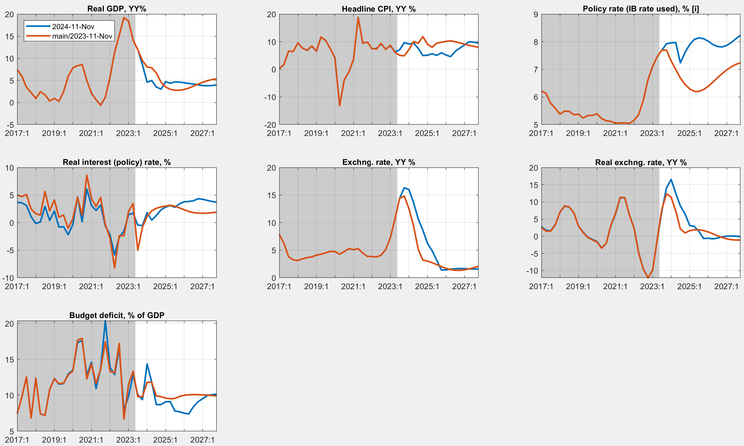
VII. Forecast evaluation (latest vs. new forecast)
Main indicators
Nov 2024 vs. Nov 2023 forecast
Effect of new observed data/info
More responsive policy and real interest rates on inflation (recalibrated reaction of IR on inflation)
More overvalued Exchange Rate (ER)—A higher ER depreciation
CPI turning to target and more accelerated post 2026
A lower budget deficit—more consolidated fiscal policies
Lower GDP growth due to tight monetary and fiscal policy

Slide 24
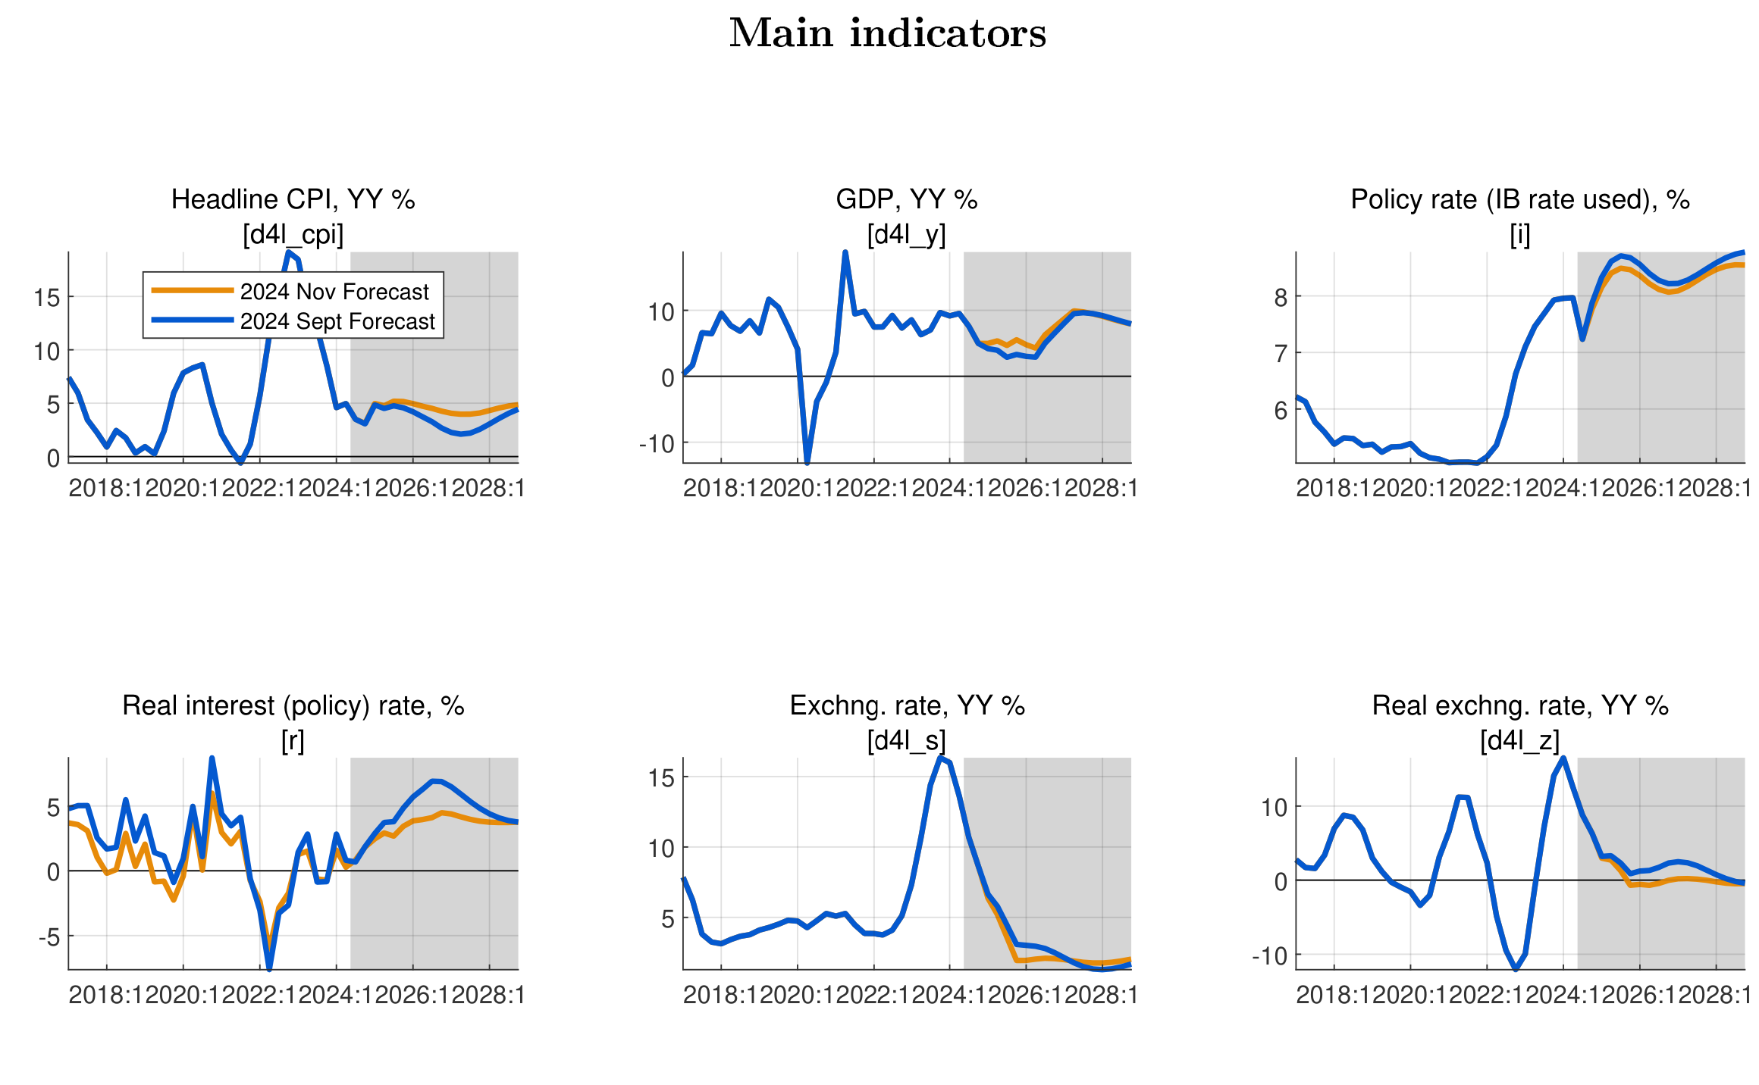
VIII. Model revision—Effect of recalibration
Main indicators
Nov 2024 vs. Sept 2023 forecasts
Effect of parameter recalibration (Incl. IB rate response to inflation and output gap, UIP and Core CPI persistence)
More responsive policy and real interest rates on inflation (recalibrated reaction of IR on inflation)
A less overvalued Exchange Rate (ER)—A less ER depreciation
CPI turning to target and more accelerated post 2026
Higher GDP growth due to less tight monetary policy.

Slide 25
IX. QMFM inter-twin with macro toolbox (nowcasting, MF…)
Calibration of elasticities and exogenous assumptions (i.e., exogenous growth rates of final demand components) for other macro-tools
During IMF Mission and Projections reviews, the QMFM quarterly estimation is useful to inform annual Real sector/MF Inyear projections.
Quarterly estimation of GDP from demand side can be useful to evaluate quarterly nowcasts
Notes:
See Output gap and Fiscal Impulse in last Chart

Slide 26
VI. Inputs for intMF projections & discussions (template)
QMFM forecast is independent assessment of macro outlook—incl. interaction of macro policies. Its demand-driven approach complements the mainly supply-driven intMF projection
Real GDP: contractionary impact of fiscal deficit reduction and RIR increase in 2025-26 suggest downward adjustment of GDP growth from intMF sum of sectoral growth rates:
for intMF consider: GDP growth around 6% in 2025-26 before catch up to 8-9% in 2027-28
CPI: the negative impact on demand of the restrictive policies—more than offsetting price-increasing effect of fast NER depreciation—should lead to subdued inflation in 2025-26:
for intMF consider: CPI rate below 5% in 2025-26
Private demand: restrictive policies slow down private investment/consumption growth, to consider in intMF where investment growth is a guess and consumption residual:
for intMF consider: real consumption growth much below trend in 2025-26
real investment growth 5-6% in 2025-26
Imports G&S: following domestic demand and GDP—compounded by recent strong RER depreciation--real imports growth is forecast to dip much below trend in 2025-26: :
for intMF consider: real import growth +6% in 2025-26 as check against BoP’s sum of import lines
Notes:
See Output gap and Fiscal Impulse in last Chart

Slide 27
VI. Inputs for intMF projections & discussions (cont’d) (template)
Exports G&S: export growth is forecast to return to trend after dip in 2024, helped by recent strong RER depreciation:
for intMF consider: real export growth +10% in 2025-26 as check against BoP’s sum of export lines
Fiscal path: 2024/25─2025/26 reflects PCI fiscal program targets (in % GDP). But the forecast from 2026/27 reflects premise that the deficit and its components be allowed to move gradually to their sustainable levels (for deficit 7.5% of GDP, before grants of 2.5%):
for intMF consider: return to sustainable deficit (and components) of 7.5% of GDP from 2026/27
Exchange rate: the forecast reflects NBR’s rule of return to ER path that first corrects for RER overvaluation, then for inflation differential with trading partners (+3% py). The 2022-23 RER overvaluation (due to the inflation surge) was more than corrected in 2024:
for intMF consider: much smaller NER depreciation rate than in 2023-24, i.e. of some 2% p.y.
Real interest rate: forecast reflects a rise back to ‘normal’ for real policy (IB) and lending rates (+8% points above real IB) as NBR raised interest rates and inflation plunged in 2024. The RIR rise has contributed to demand restraint in 2024-26. Beyond 2026, RIR reflect higher world RIR (1.5% from 2026, compared to 0% in 2023).
for intMF consider: how does the forecast RIR affect real private domestic demand?
Notes:
See Output gap and Fiscal Impulse in last Chart

Slide 28
THANK YOU

Slide 29
X. Data issues and requests & suggestions
Model/Outlook data issues to be addressed
intMF – fiscal: accurate govt demand for G&S, more timely and reliable Q data, timely Q treasury plan
– debt: timely & complete Q data (showing IMF separately) and projections integrated into intMF
NA/NISR – discrepancies/anomalies Govt consumption, investment, inventories, final demand deflators
NBR – more timely Q BoP data, as input for models and intMF
NBR-FPAS results, analysis of potential output, international interest rates (GPM)
WEOGAS & GEE in right format– timely sharing by IMF staff, QoQ projection instead of YoY
timely data reconciliation and iterative comparison of forecast results from various tools
input for intMF well before each Review and each quarter
Notes:
MINECOFIN can have a different assessment of path and impact of monetary and ER policies than NBR, just as NBR can have a different assessment of path and impact of fiscal policies.

Slide 30
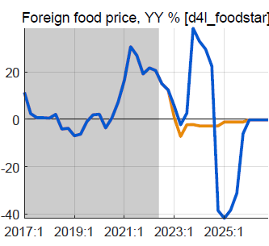
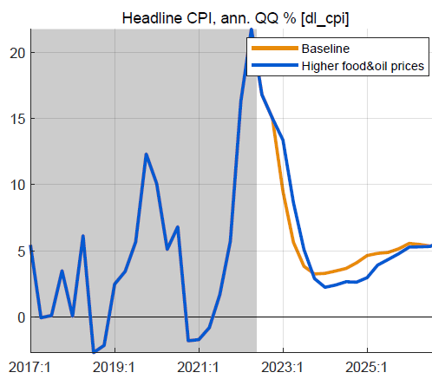
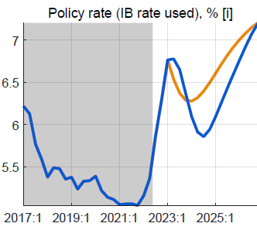
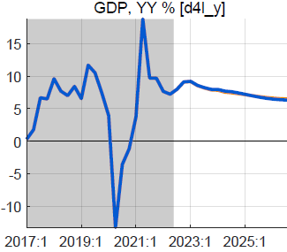
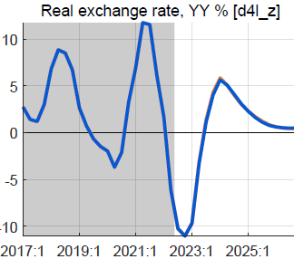
XI. Alternative scenario: higher foreign food/oil prices (2023-24)
Higher-than-WEO foreign food and oil prices in 2023-24
foreign food and oil prices on average 25% higher than BL
with peak around end-2023, return to WEO levels from 2025
no change in fiscal policy
Results in higher headline CPI, little or no effect on output
headline CPI temporarily higher, reflecting food/oil import shares
small response policy rate, reversed fast as expected inflation drops
small positive effect on demand of lower RIR
mostly offset by negative effect of slightly more appreciated RER
overall effect on GDP is very small, less than 0.2%

Slide 31
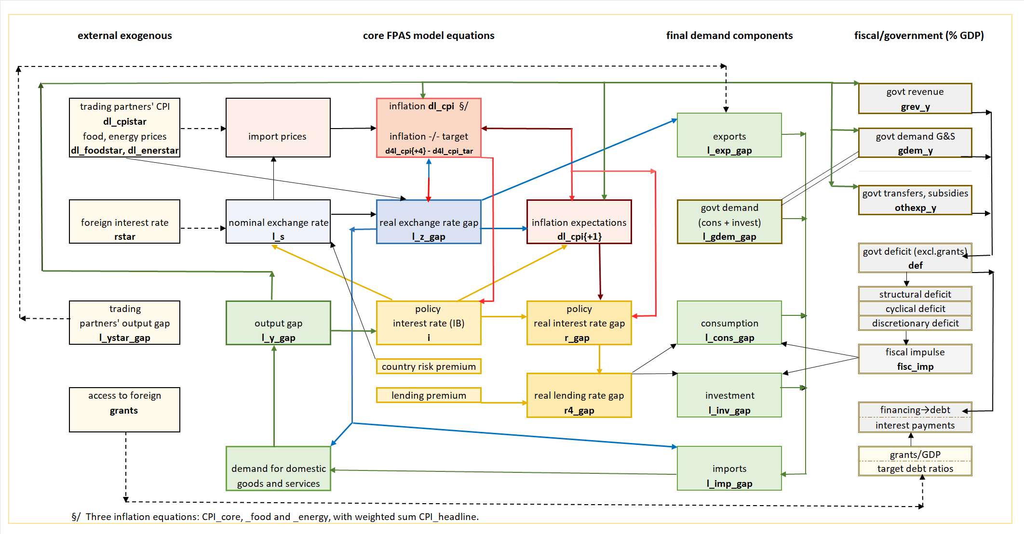
VIII. QMFM: main relationships and transmission mechanisms

